Slide 1
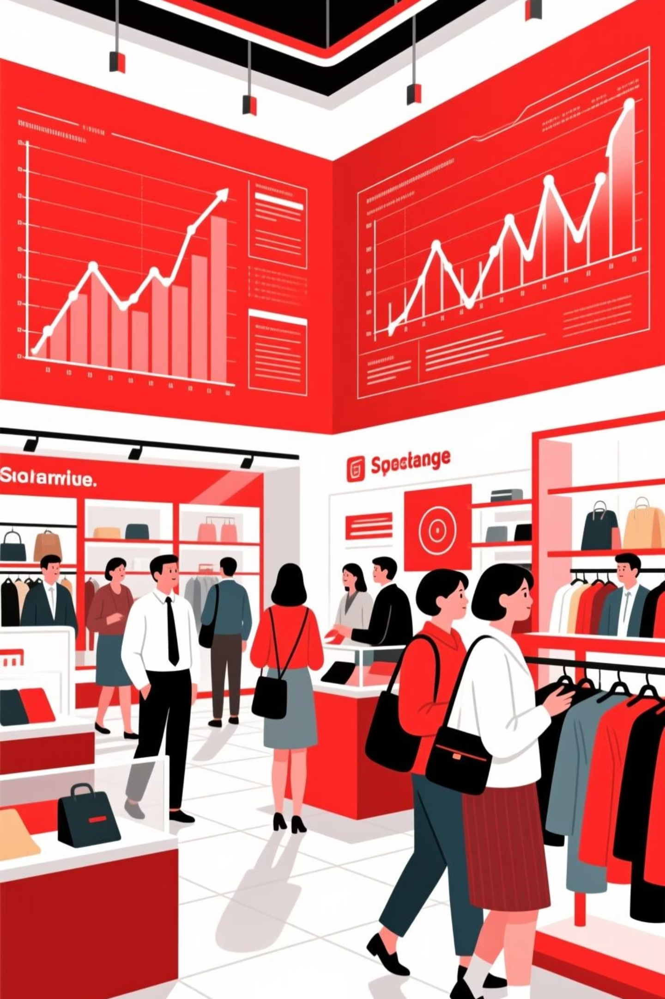
Customer Shopping Behavior Analysis
Analyzing 3,900 purchases to uncover insights into spending patterns, customer segments, and strategic opportunities

Slide 2
Dataset Overview
3,900
18
37
Total Purchases
Data Columns
Missing Values
Transactions analyzed
Feature variables tracked
In Review Rating column
Demographics
Purchase Details
Shopping Behavior
Age, Gender, Location, Subscription Status
Item, Category, Amount, Season, Size, Color
Discounts, Previous Purchases, Frequency, Ratings, Shipping

Slide 3
Data Preparation Process
01
02
03
Data Loading & Exploration
Missing Data Handling
Column Standardization
Imported dataset using pandas, analyzed structure with df.info() and summary statistics
Imputed Review Rating nulls using median rating per product category
Renamed columns to snake case for consistency and readability
04
05
Feature Engineering
Database Integration
Created age_group and purchase_frequency_days columns
Connected to PostgreSQL and loaded cleaned data for SQL analysis

Slide 4

Revenue Insights by Gender
Gender Revenue Analysis
Compared total revenue generated by male vs. female customers to identify spending patterns
Key insight for targeted marketing strategies and product positioning

Slide 5

Customer Spending Patterns
High-Spending Discount Users
Shipping Type Comparison
Top-Rated Products
5 products with highest average review ratings drive customer satisfaction
Customers using discounts but spending above average purchase amount
Express shipping: higher average purchase amounts vs. Standard

Slide 6
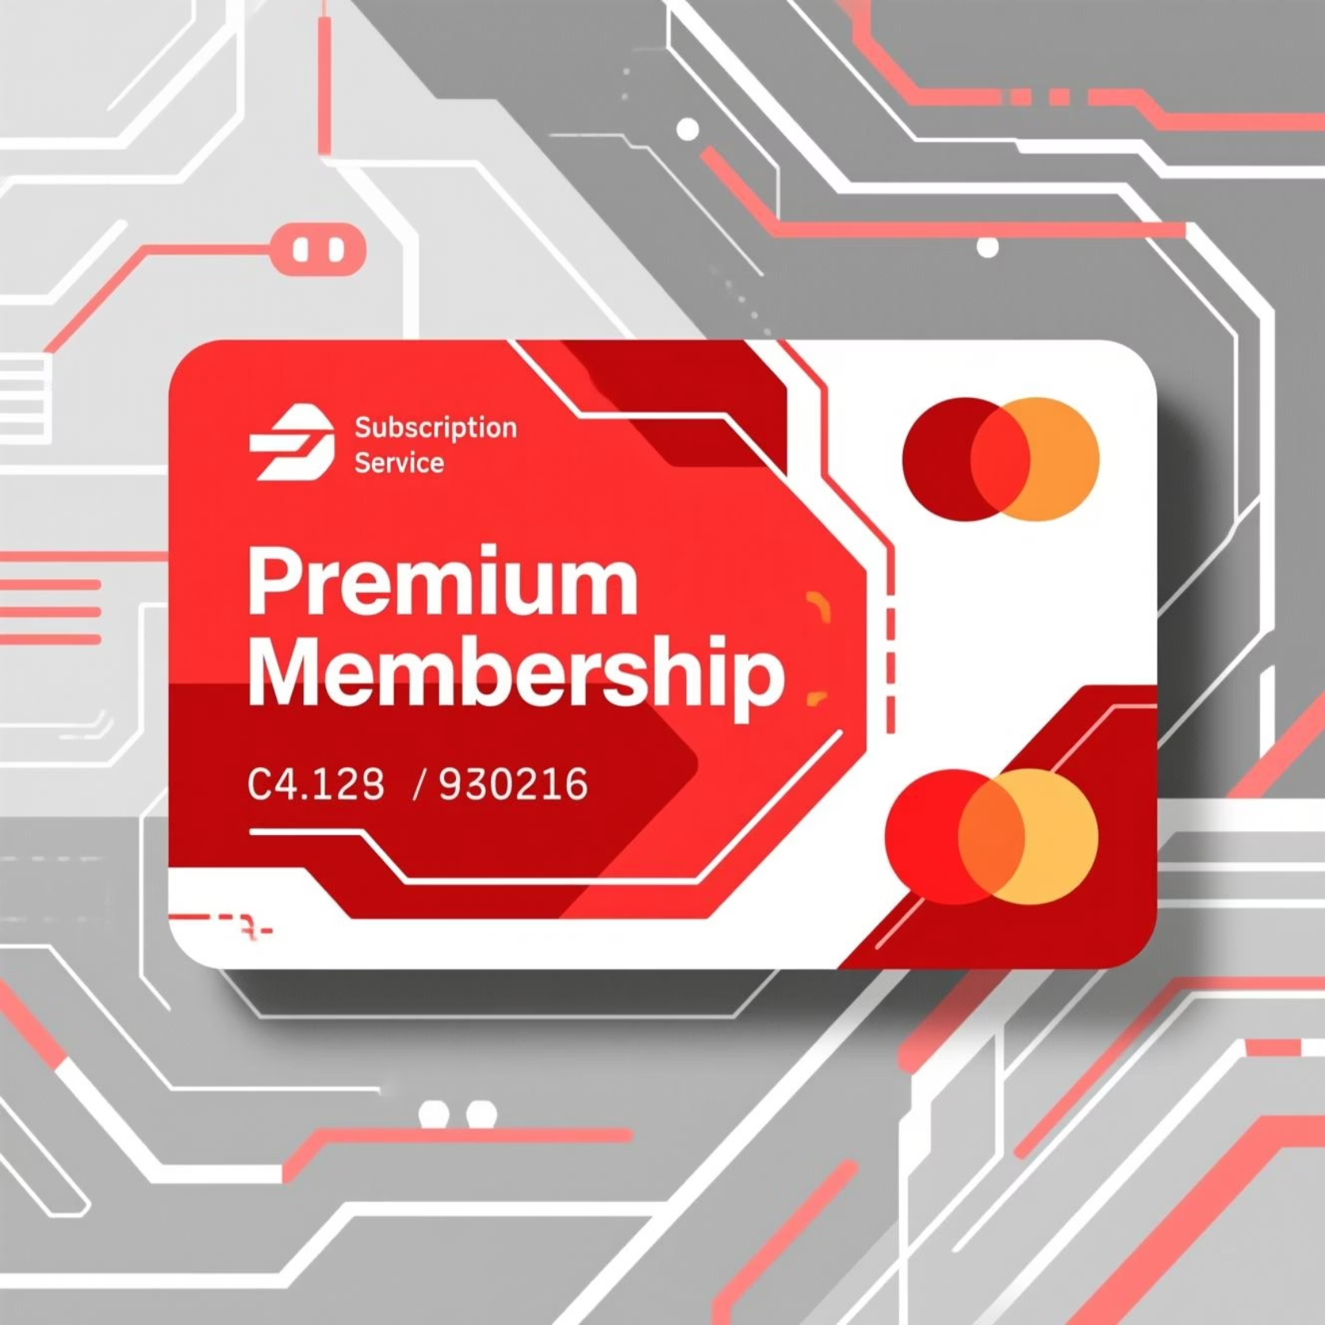
Subscription Impact
Subscribers vs. Non-Subscribers
Average spend comparison:
Subscribers show higher average purchase amounts
Total revenue significantly boosted by subscription base
Repeat buyers (>5 purchases) more likely to subscribe

Slide 7



Customer Segmentation
1
Loyal
2
Returning
3
New
Classified customers based on purchase history to identify growth opportunities and retention strategies

Slide 8
Product & Category Performance
Top 3 Products per Category
Discount-Dependent Products
Revenue by Age Group
Most purchased items within each category identified
Total revenue contribution calculated for each age segment
5 products with highest percentage of discounted purchases

Slide 9

Interactive Dashboard
Built comprehensive Power BI dashboard presenting insights visually for stakeholder decision-making

Slide 10

Strategic Recommendations
Boost Subscriptions
Loyalty Programs
Review Discount Policy
Promote exclusive benefits for subscribers
Reward repeat buyers to move into "Loyal" segment
Balance sales boosts with margin control
Product Positioning
Targeted Marketing
Highlight top-rated and best-selling products
Focus on high-revenue age groups and express-shipping users

